Slide 1
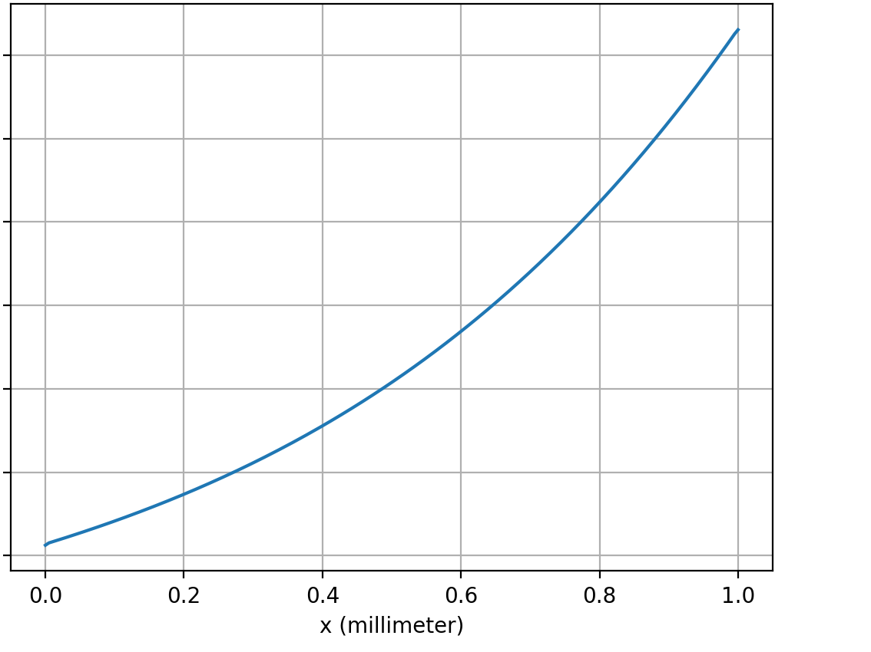
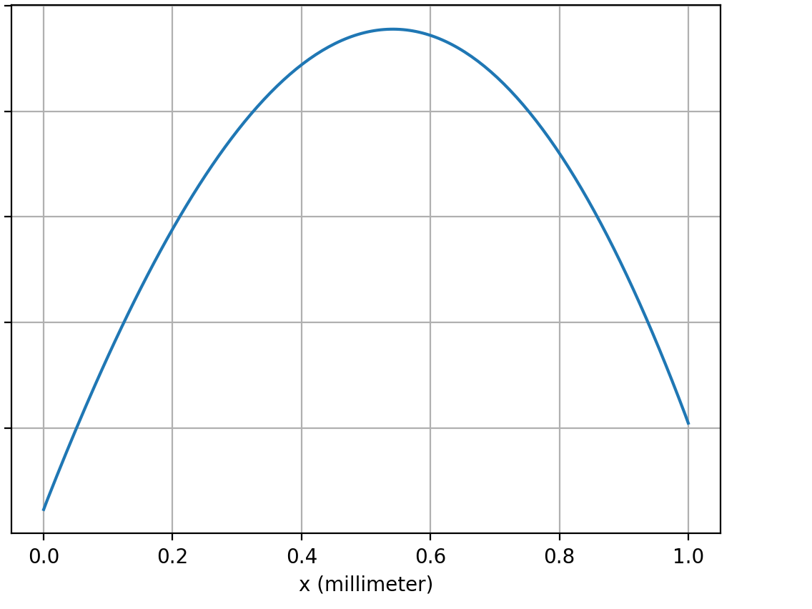
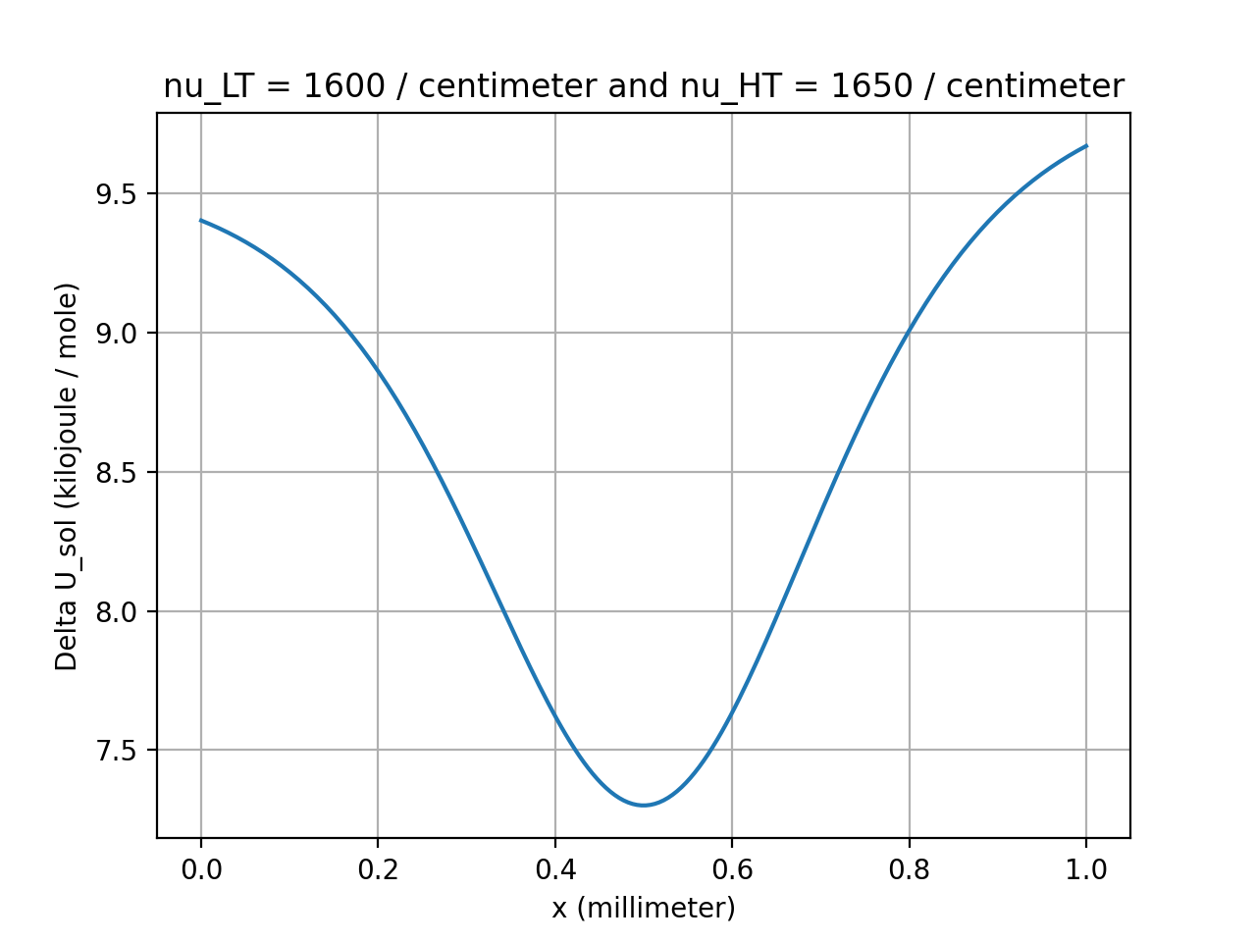




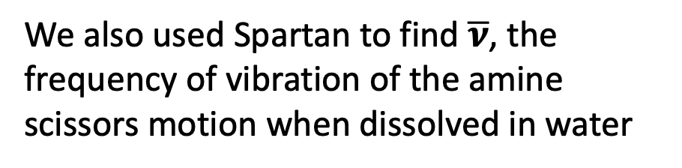


Last time we talked about how ${∆U}_{sol}$ allows us to predict thermophoretic properties
$${∆U}_{sol}$$
$${∆U}_{sol}$$
$${∆U}_{sol}$$
We also used Spartan to find $\overline{ν}$, the frequency of vibration of the amine scissors motion when dissolved in water

Slide 2
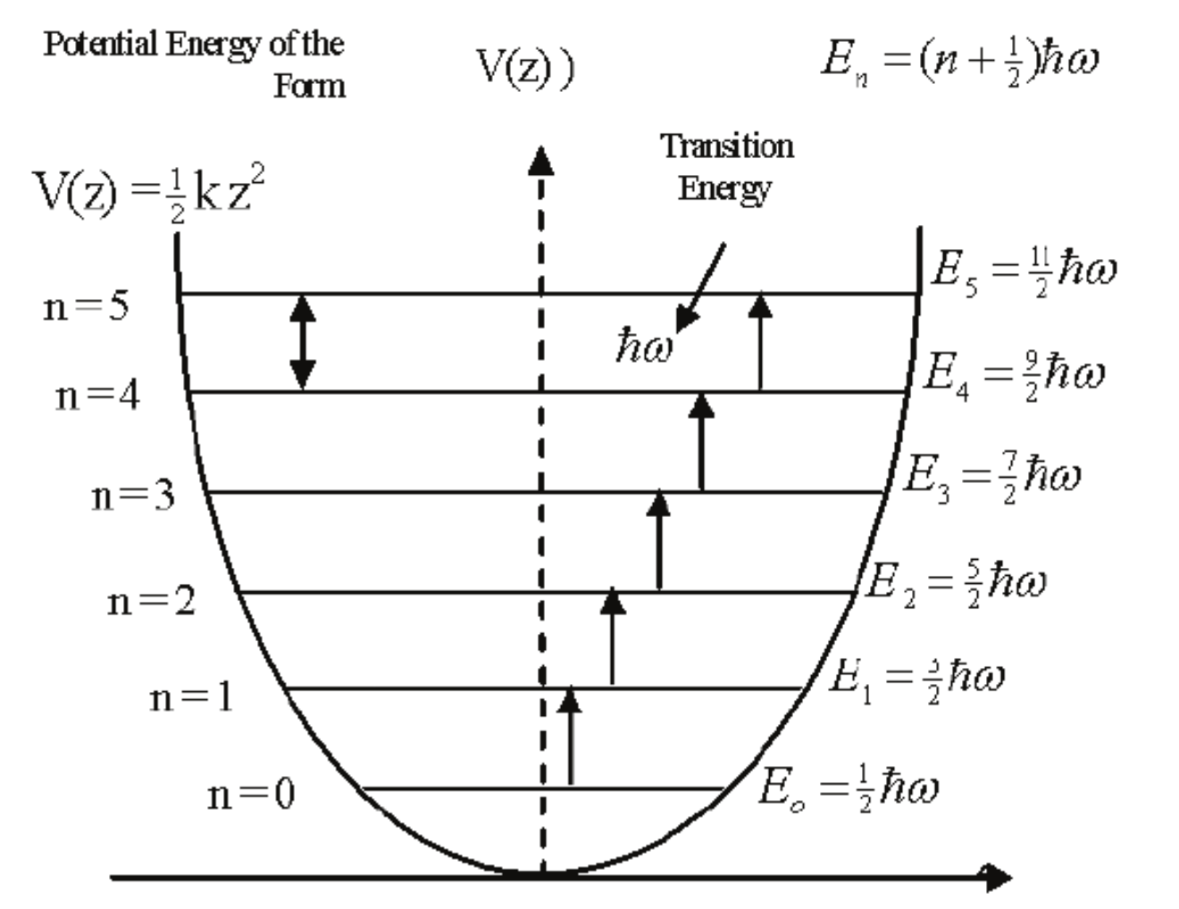
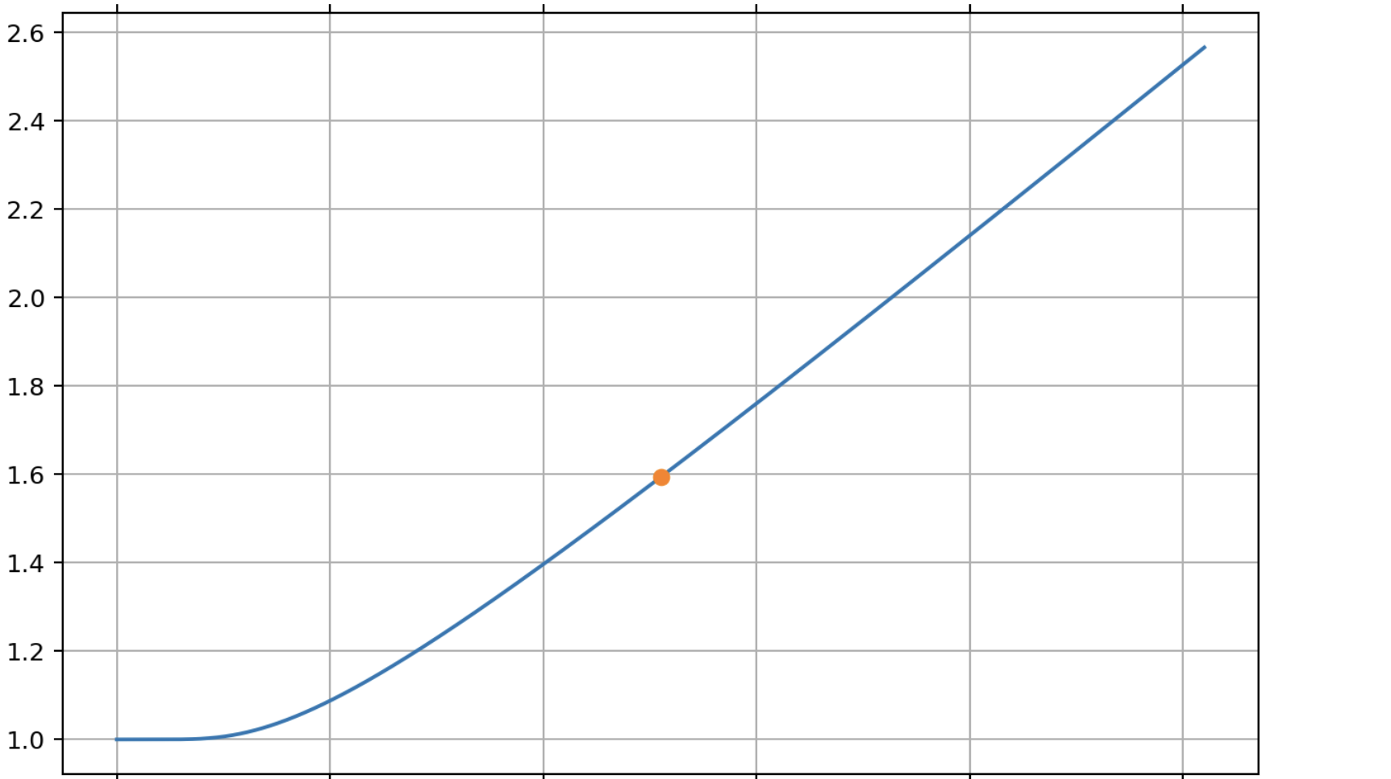

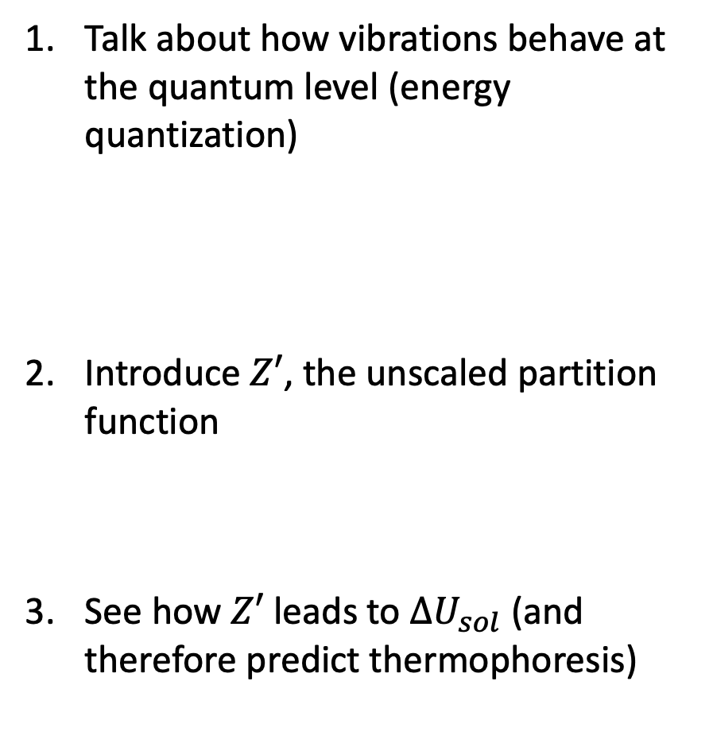



Roadmap from vibrations -> partition functions -> ${∆U}_{sol}$
Talk about how vibrations behave at the quantum level (energy quantization)
Introduce $Z′$, the unscaled partition function
See how $Z′$ leads to ${∆U}_{sol}$ (and therefore predict thermophoresis)
$Z′$
$$T$$
$${∆U}_{sol}$$
$$x$$

Slide 3
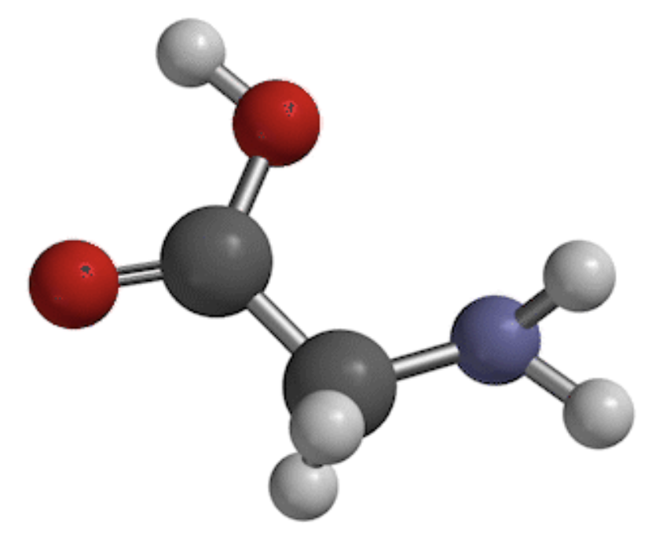
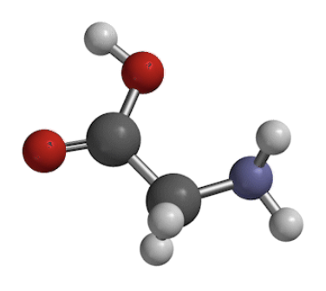
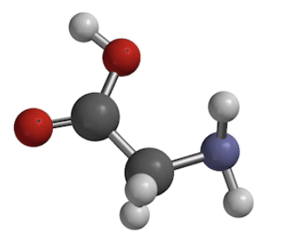


Quantization of energy of molecular vibration
$$E_{gap}$$
Compressed
Equilibrium
Stretched-out

Slide 4
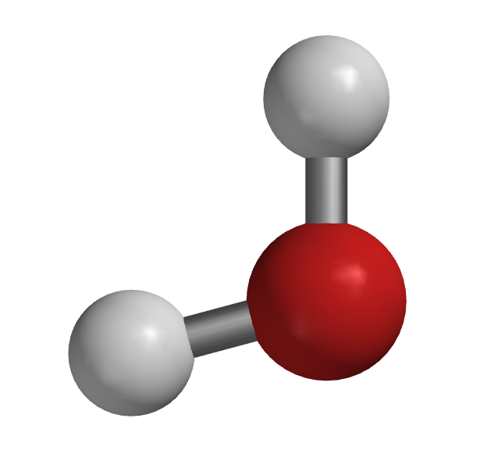

If T is too low, molecules can’t get enough energy from collisions to get vibrationally excited
$$E_{gap}$$
A little bump
Solute in vibrational ground state
Cold incoming solvent
Compressed
Equilibrium
Stretched-out

Slide 5
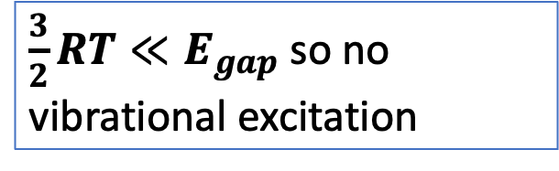
If T is too low, molecules can’t get enough energy from collisions to get vibrationally excited
$\frac{3}{2}RT≪E_{gap}$ so no vibrational excitation
$$E_{gap}$$
A little bump
Solute in vibrational ground state
Cold incoming solvent
Compressed
Equilibrium
Stretched-out

Slide 6
At high enough T, molecules CAN get enough energy from collisions to get vibrationally excited
$$E_{gap}$$
Bam!
Solute in vibrational ground state
Incoming solvent molecule
Compressed
Equilibrium
Stretched-out

Slide 7
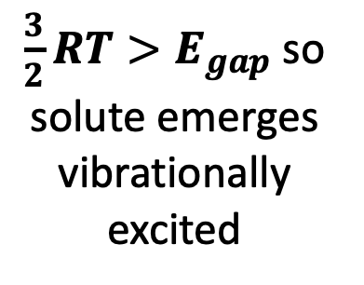
At high enough T, molecules CAN get enough energy from collisions to get vibrationally excited
$\frac{3}{2}RT>E_{gap}$ so solute emerges vibrationally excited
$$E_{gap}$$
Bam!
Solute in vibrational ground state
Incoming solvent molecule
Compressed
Equilibrium
Stretched-out

Slide 8
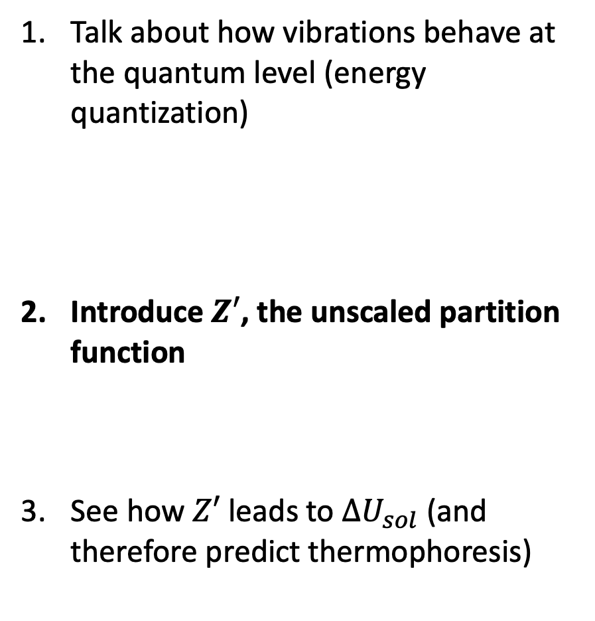
Roadmap from vibrations -> partition functions -> ${∆U}_{sol}$
Talk about how vibrations behave at the quantum level (energy quantization)
Introduce $Z′$, the unscaled partition function
See how $Z′$ leads to ${∆U}_{sol}$ (and therefore predict thermophoresis)
$Z′$
$$T$$
$${∆U}_{sol}$$
$$x$$

Slide 9
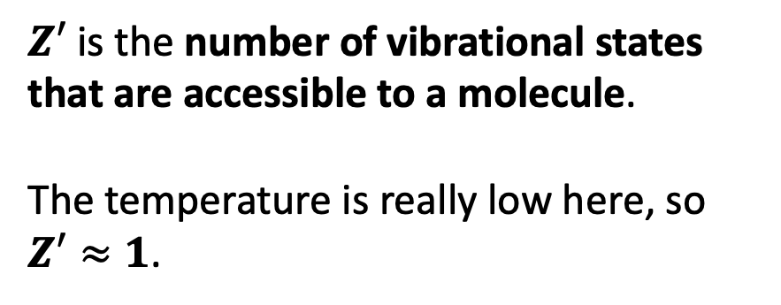
Introducing $Z′$ (the unscaled part of the partition function)
$Z′$ is the number of vibrational states that are accessible to a molecule.
The temperature is really low here, so $Z′≈1$.
$$E_{gap}$$

Slide 10
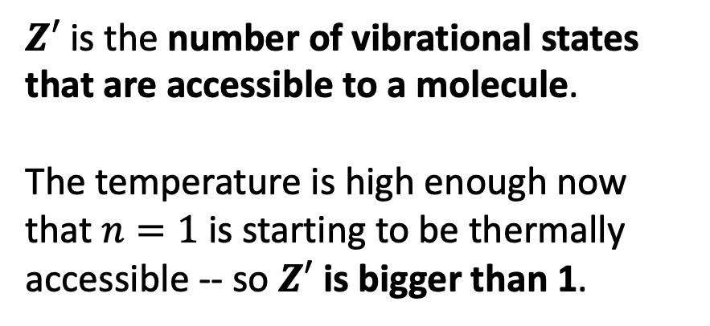
Introducing $Z′$ (which we’re calling the unscaled part of the partition function)
$Z′$ is the number of vibrational states that are accessible to a molecule.
The temperature is high enough now that $n=1$ is starting to be thermally accessible -- so $Z′$ is bigger than 1.
$$E_{gap}$$

Slide 11
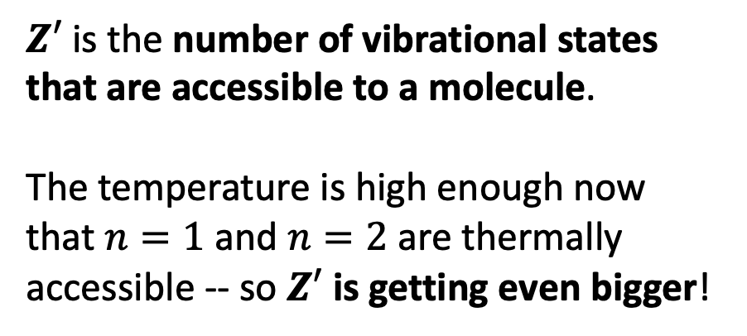
Introducing $Z′$ (which we’re calling the unscaled part of the partition function)
$Z′$ is the number of vibrational states that are accessible to a molecule.
The temperature is high enough now that $n=1$ and $n=2$ are thermally accessible -- so $Z′$ is getting even bigger!
$$E_{gap}$$

Slide 12
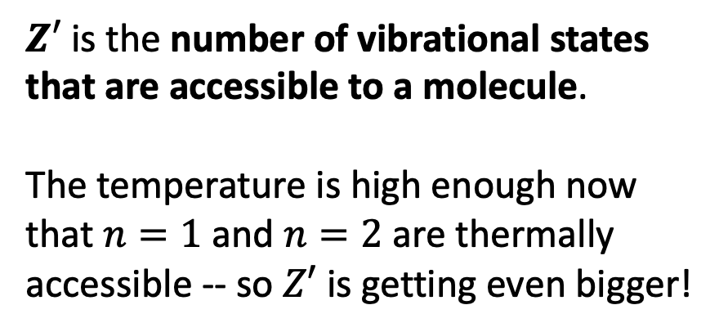
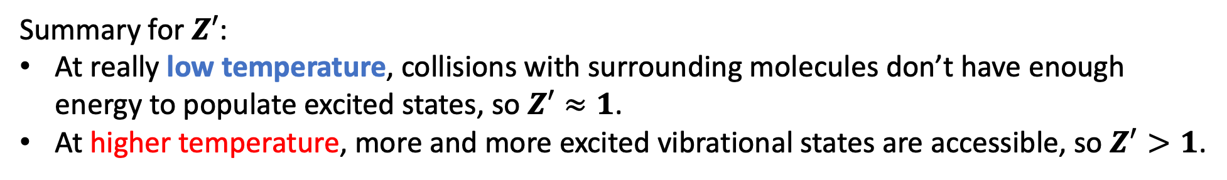
Introducing $Z′$ (which we’re calling the unscaled part of the partition function)
$Z′$ is the number of vibrational states that are accessible to a molecule.
The temperature is high enough now that $n=1$ and $n=2$ are thermally accessible -- so $Z′$ is getting even bigger!
$$E_{gap}$$
Summary for $Z′$:
At really low temperature, collisions with surrounding molecules don’t have enough energy to populate excited states, so $Z′≈1$.
At higher temperature, more and more excited vibrational states are accessible, so $Z^{′}>1$.

Slide 13


Getting $Z′$ from $\overline{ν}$ and $T$
Start with $\overline{ν}$, the frequency of vibration you got from Spartan

Slide 14
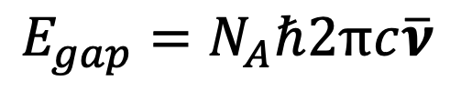


Getting $Z′$ from $\overline{ν}$ and $T$
Start with $\overline{ν}$, the frequency of vibration you got from Spartan
$$E_{gap}=N_{A}ℏ2πc\overline{ν}$$
$$E_{gap}$$

Slide 15
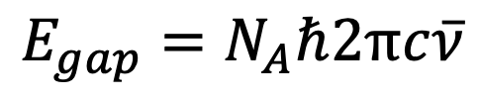
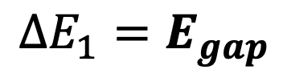

Getting $Z′$ from $\overline{ν}$ and $T$
Start with $\overline{ν}$, the frequency of vibration you got from Spartan
$$E_{gap}=N_{A}ℏ2πc\overline{ν}$$
$$∆E_{1}=E_{gap}$$
$$E_{gap}$$
$$∆E_{1}$$

Slide 16

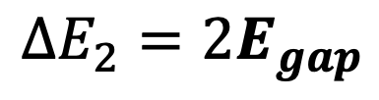

Getting $Z′$ from $\overline{ν}$ and $T$
Start with $\overline{ν}$, the frequency of vibration you got from Spartan
$$E_{gap}=N_{A}ℏ2πc\overline{ν}$$
$$∆E_{2}=2E_{gap}$$
$$E_{gap}$$
$$E_{gap}$$
$$∆E_{2}$$

Slide 17
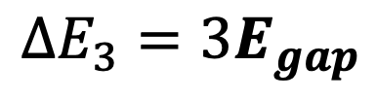


Getting $Z′$ from $\overline{ν}$ and $T$
Start with $\overline{ν}$, the frequency of vibration you got from Spartan
$$E_{gap}=N_{A}ℏ2πc\overline{ν}$$
$$∆E_{3}=3E_{gap}$$
$$E_{gap}$$
$$E_{gap}$$
$$∆E_{3}$$
$$E_{gap}$$

Slide 18
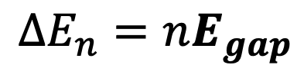
Getting $Z′$ from $\overline{ν}$ and $T$
Start with $\overline{ν}$, the frequency of vibration you got from Spartan
$$E_{gap}=N_{A}ℏ2πc\overline{ν}$$
$$E_{gap}$$
$$∆E_{n}=nE_{gap}$$
$$E_{gap}$$
$$E_{gap}$$
$$E_{gap}$$
$$E_{gap}$$

Slide 19
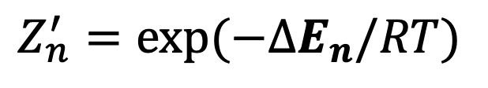

Getting $Z′$ from $\overline{ν}$ and $T$
Start with $\overline{ν}$, the frequency of vibration you got from Spartan
$$E_{gap}=N_{A}ℏ2πc\overline{ν}$$
$$E_{gap}$$
$$∆E_{n}=nE_{gap}$$
$$E_{gap}$$
$$E_{gap}$$
$Z_{n}^{′}=exp⁡(−∆E_{n}/RT)$
$$E_{gap}$$
$$E_{gap}$$

Slide 20
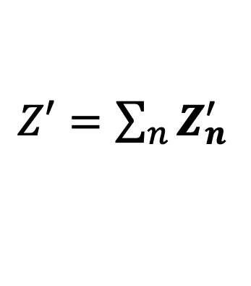

Getting $Z′$ from $\overline{ν}$ and $T$
Start with $\overline{ν}$, the frequency of vibration you got from Spartan
$$E_{gap}=N_{A}ℏ2πc\overline{ν}$$
$$E_{gap}$$
$$∆E_{n}={nE}_{gap}$$
$$E_{gap}$$
$$E_{gap}$$
$Z_{n}^{′}=exp⁡(−∆E_{n}/RT)$
$$E_{gap}$$
$$E_{gap}$$
$Z′=\sum_{n}{Z_{n}^{′}}$

Slide 21

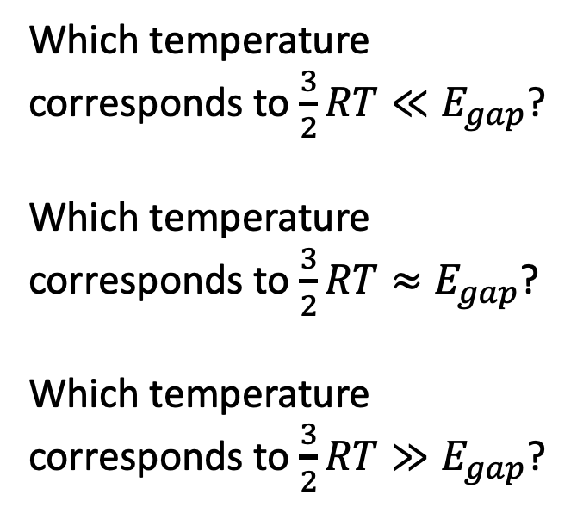

Graphical depiction of $Z′$ … this is a big qualitative take-home point of this week
Which temperature corresponds to $\frac{3}{2}RT≪E_{gap}$?
Which temperature corresponds to $\frac{3}{2}RT≈E_{gap}$?
Which temperature corresponds to $\frac{3}{2}RT≫E_{gap}$?
$$Z′$$
$$T$$

Slide 22
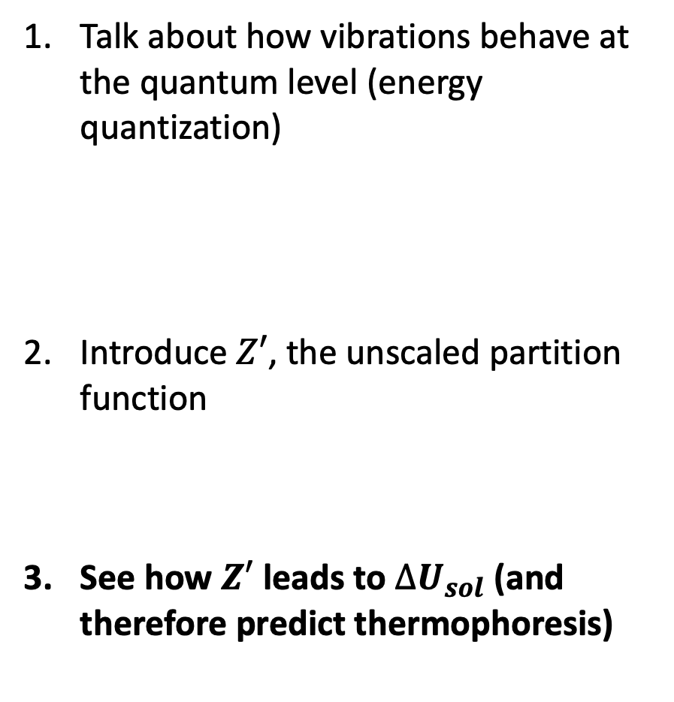
Roadmap from vibrations -> partition functions -> ${∆U}_{sol}$
Talk about how vibrations behave at the quantum level (energy quantization)
Introduce $Z′$, the unscaled partition function
See how $Z′$ leads to ${∆U}_{sol}$ (and therefore predict thermophoresis)
$Z′$
$$T$$
$${∆U}_{sol}$$
$$x$$

Slide 23
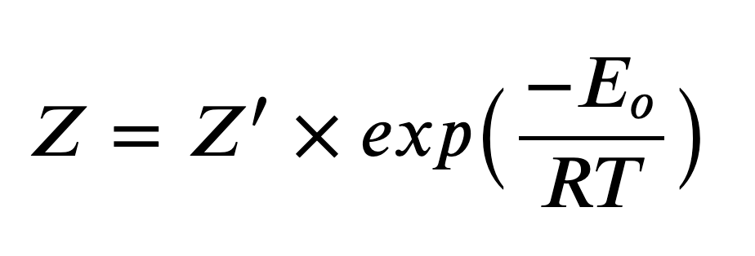
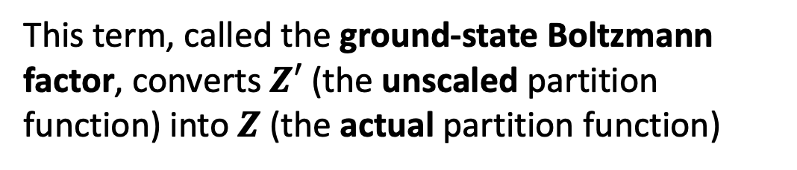

How $∆U_{sol}$ depends on $Z′$
This term, called the ground-state Boltzmann factor, converts $Z′$ (the unscaled partition function) into $Z$ (the actual partition function)

Slide 24
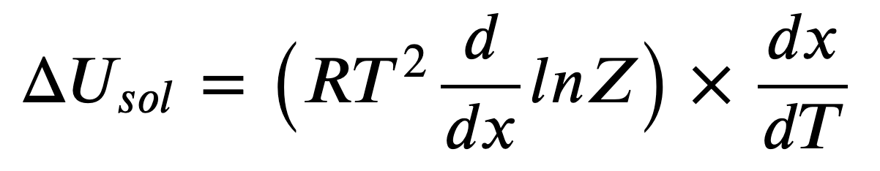
How $∆U_{sol}$ depends on $Z′$
This term, called the ground-state Boltzmann factor, converts $Z′$ (the unscaled partition function) into $Z$ (the actual partition function)
This is the solute’s temperature-dependent free energy of solvation (according to StatMech) that lets us predict thermophoresis

Slide 25

How $∆U_{sol}$ depends on $Z′$
This term, called the ground-state Boltzmann factor, converts $Z′$ (the unscaled partition function) into $Z$ (the actual partition function)
$$∆U_{sol}$$
This is the solute’s temperature-dependent free energy of solvation (according to StatMech) that lets us predict thermophoresis

Slide 26
How $∆U_{sol}$ depends on $Z′$
This term, called the ground-state Boltzmann factor, converts $Z′$ (the unscaled partition function) into $Z$ (the actual partition function)
$$∆U_{sol}$$
This is the solute’s temperature-dependent free energy of solvation (according to StatMech) that lets us predict thermophoresis
Now we have to make this happen in Python

